Slide 1

Brand Servicing
Soft Skills
Notes:
Main Title Page

Slide 2
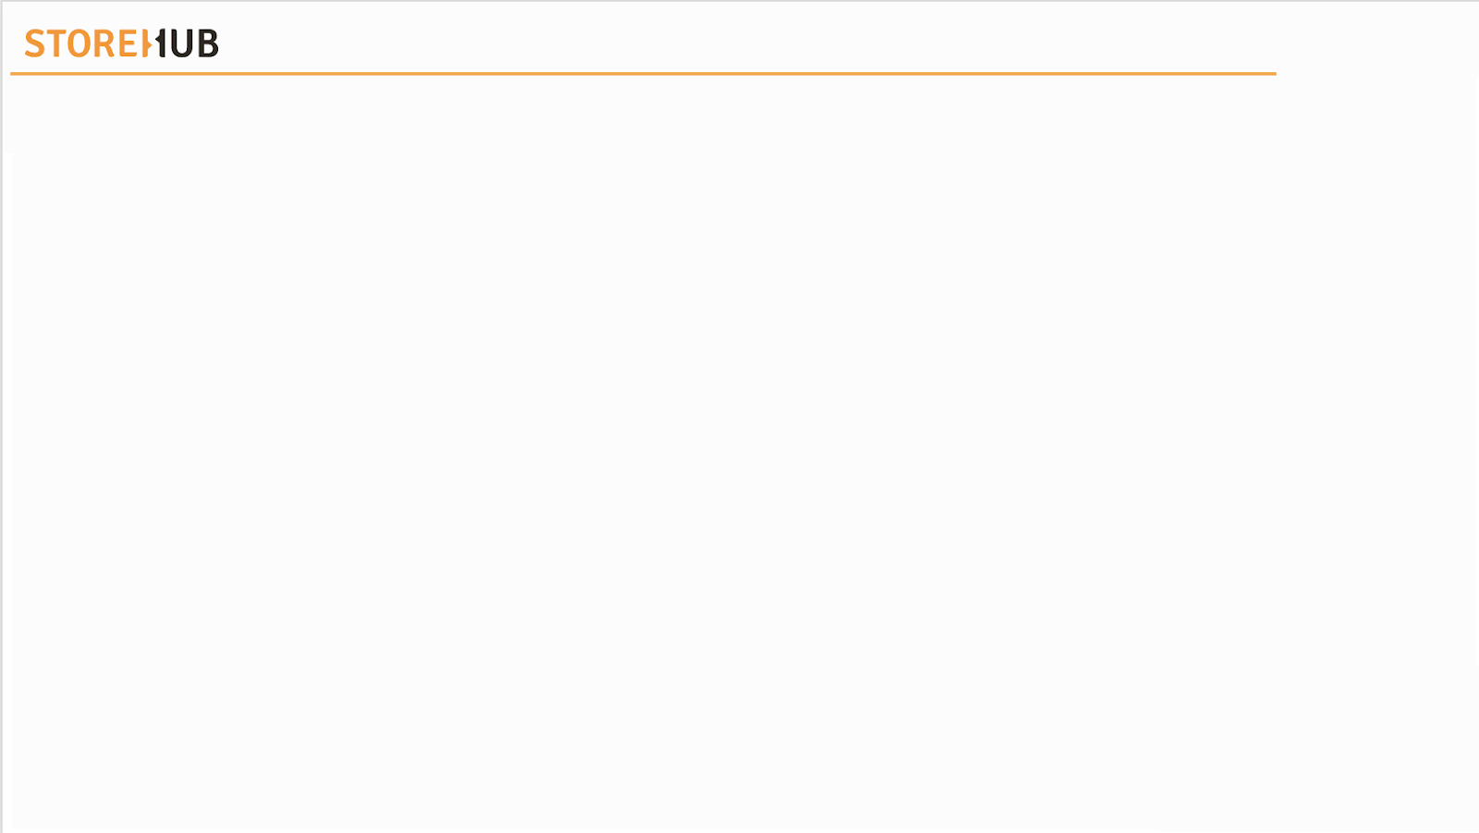





| Brand Servicing
Table of Contents
Customer Experience
Pillars
Level Up
Role Play

Slide 3
Customer Experience

Slide 4

Customer Experience
Introduction
POS = Point of Sales

Slide 5

Customer Experience
Introduction
What is Brand Servicing?
What is Customer Experience?
For StoreHub, it means
ensuring our merchants / customers have an awesome experience when communicating with us.
Impact that players created for merchants / customers while communicating with SH
SH = StoreHub

Slide 6
Customer Experience
Growth VS Fixed Mindset
Fixed Mindset
Always rationalising why I cannot do it
Feel stuck with no options
Skills
Fixed Mindset
Something to avoid
Could reveal my lack of skills
Tend to give up easily
Challenges
It’s too hard, I can’t do it
The effort won't be worth it
Short-term focused, gratification
Effort
Gets defensive
Take it personally
Mental shut down
Feedback
I am not good enough
Blame others
Gets discouraged
Setbacks

Slide 7
Customer Experience
Growth VS Fixed Mindset
Growth Mindset
Skills
At first it’s hard, but I will improve
Persistence is key
Comes from hard work
Should be embraced
Facing fears with curiosity
An opportunity to grow
Challenges
There has to be a solution
I can find a way
Long-Term focused, bigger mission
Effort
Useful for my growth
Something to learn from
Identify areas to improve
Growth Mindset
Feedback
Take responsibility
Accountable for my actions
Reflect, review & go again
Setbacks

Slide 8


Customer Experience
Growth Mindset
Instead of……
I’m not good at this
I give up
It’s good enough
I can’t make this any better
This is too hard
I made a mistake
I’ll never be that smart
Plan A didn’t work
My friend can do it
Try Thinking……
What am I missing?
I’ll use a different strategy
Is this really my best work?
I can always improve
This may take some time
Mistakes help me to learn
I will learn how to do this
There’s always a Plan B
I will learn from them

Slide 9



Customer Experience
Growth Mindset
Think of a solution
Happy Customer!
First Contact Resolution

Slide 10

Customer Experience
Growth Mindset
Click on link!
POS = Point of Sales

Slide 11
Pillars

Slide 12



Pillars
3 Pillars of Servicing
Easy
Conduct a conversation that feels easy and natural for our Customers
Recognize
Acknowledge and recognize the difficulties they face
Solve
Whatever issues they have, we will take responsibility for resolving them

Slide 13
Level Up

Slide 14






Level Up
Flow
Greetings
Probing
Solutions
Objection
Closing

Slide 15
Level Up
Flow - Greetings
The better your connection with customer, the easier to understand their True need
Tips
Build Rapport
Warm welcome
Emotional connection
Speak with a smile
Notes:
Less word to more word

Slide 16
Level Up
Flow - Probing
Understanding merchant’s reasons better
Taking Ownership to assist
Tips
Discover Customer’s “NWC” and Profile
Needs
Wants
Concerns

Slide 17
Level Up
Flow - Solutions
Acknowledge callers “NWC”.
Tips
Offer Suitable Solution
Value statement
Address true needs
Personalise solutions

Slide 18

Level Up
Flow - Objection
An objection is when a Customer says "NO" to an solution / offer
Tips
Handle Objection
Objection Handling
Managing Escalations
Value Statements

Slide 19
Level Up
Flow - Closing
Ensure that Customer’s inquiries is solve
Tips
Closing
Recap
Fond Farewell
Self-service Tool

Slide 20

Greetings

Slide 21
Greeting
Introduction
Greeting
Warm
Friendly and enthusiastic
“Presenting in a most pleasant manner that connect both sides”
Smile
Speak with emotion
Connection
Build rapport between player and merchant/customer
Value
Objective driven
Clarity
Make your point clearly

Slide 22



Greeting
Warm
Too quiet or loud
Aggressive
Robotic
Fixed
Lifeless
Natural
Comfortable
Emotional
Flexible
Lively

Slide 23


Greeting
Smile
“Good morning!
Thank you for calling StoreHub.
This is Andrea. May I know who am I speaking to?”
CARE
“Good morning!
Thank you for calling Beep by StoreHub.
This is Ben. May I know who am I speaking to?”
BEEP

Slide 24
Greeting
Connection
Customer ask on a features & benefits
CARE
“Of course! I will be happy to look into that for you. To get started, allow me to get some information from you.”
Customer inform us of an issue with HW / SW / Beep Delivery
“I apologize for the experience. Don’t worry about it, I am here for you. To get started, allow me to get some information from you."
BEEP
HW = Hardware | SW = Software

Slide 25



Greeting
Value
Hello, may I speak with Ms. Jade?
Yes. Jade speaking.
I am Jessica from StoreHub Customer Care Team. I would like to discuss with you in regards to the concerns you have raised to us about your hardware. Is it a convenient time to speak to you now? It will take only about 10 mins.
Important Note!
It is important for players to inform the merchants upfront on the purpose of the call at the beginning.
DO NOT start with the conversation if “they are free to speak now” without relaying the agenda of the call.
CARE

Slide 26
Greeting
Value (cont.)
Hello, may I speak with Ms. Jade?
Yes. Jade speaking.
I am Yeina from Beep by StoreHub. I would like to provide an update on your recent order from our app. Is it a convenient time to speak with you now? It will take only about 10 mins.
Important Note!
BEEP
It is important for players to inform the merchants upfront on the purpose of the call at the beginning.
DO NOT start with the conversation if “they are free to speak now” without relaying the agenda of the call.

Slide 27
Greeting
Clarity
Customer says the time is right to speak now
“Thank you for your confirmation. Before I proceed, I want to inform you that our conversation may be recorded for quality and training purposes.”
Customer says he/she is busy at the moment
“I see, may I know when is the most convenient date/time for me to contact you again?”

Slide 28

Probing

Slide 29
Probing
Introduction
Probing
Active Listening
Listen for the intention to understand
“Discover customer’s needs, wants & concern”
Empathy
Acknowledge customer/merchant‘s emotion
Patience
Make no hasty verdicts

Slide 30




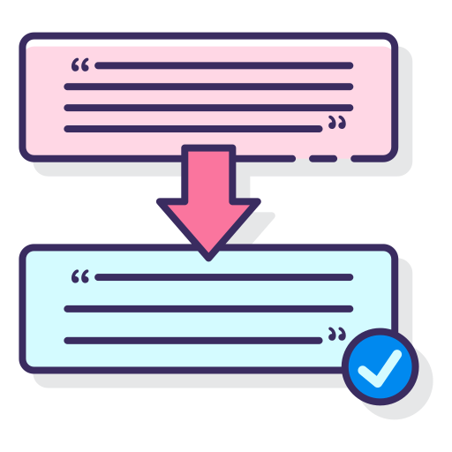

Probing
Active Listening
Mental Notes
Acknowledge
Focus
Paraphrase
Reassurance

Slide 31
Probing
Active Listening - Do’s & Don’ts
DO’S
Do’s
DON’TS
Paraphrase Customer / Merchant ’s concern to avoid misunderstanding / miscommunication
Clarify if Customer wishes to proceed with the request or just inquiring
Ensure to have Customer's acknowledgement before making any changes to the booking
Assuming Customer’s concern/ request without clarifying
Misinterpret Customer’s concerns with requests instead of inquiries
Make changes on Customer’s booking without having their consent
Don’ts

Slide 32




Probing
Active Listening - Do’s & Don’ts (Scenario)
Can I cancel this booking?
Can I cancel this booking?
Yes. I already cancelled the booking for you with 10% handling fee.
Yes. You may cancel this booking before 12:00pm and there will be a 10% handling fee. Please let us know if you would like to proceed for cancellation and refund request.
I didn’t want to cancel the booking yet. I’m just checking with you!
Yes. Cancel.
Thank you for the clarification. We will assist you to proceed with cancellation and refund with 10% handling fee.
Once booking is cancelled, we are unable to retrieve your booking back.

Slide 33

Probing
Active Listening
Notes:
S: Stop
B: Breath
L; Listen
R: Respond

Slide 34

Probing
Empathy
Listen before you speak
Respect everyone cultural differences
Control your cadence, pace and tone
Validate concern by restating and echoing back other’s feelings and perspective

Slide 35
Probing
Empathy vs. Sympathy
Empathy refers to acknowledgment and affirmation of another’s emotional state.
Sympathy involves identifying with and even taking on another person’s emotions.
Empathy
Sympathy
I am so sorry for your loss; I can't imagine what is going through your mind.
I understand the situation you're in right now, let me see what I can do.
I hope you feel better soon.
This must be hard for you.
I am very sorry for what happened…
Acknowledge the situation and show that you care
Acknowledge on the situation

Slide 36
Probing
Empathy vs. Sympathy
I understand why you feel that way
I’m sorry for your loss / to hear that…
Thank you for remaining so positive
If I were in your position, I’d feel the same way
I can’t imagine what you’ve been through
I completely understand where you’re coming from
Thank you for being so understanding

Slide 37
Probing
Empathy
LOVE
CARING
nurturing
EMPATHY
relating
understanding
COMMUNICATION
Show that we
LOVE and CARE
Make customer feel
Important and Welcome

Slide 38

Probing
Empathy
POS = Point of Sales

Slide 39
Probing
Patience – Do’s & Don’ts
Do’s
Listen to the customer
Not listening to the customers
Don'ts
Listening to the customers would help to alleviate their current frustrations.
By not listening to the customers would make them frustrate further and lose trust.
Be Attentive
Not Understanding
Be attentive on what your customers are telling you without directly saying it
Providing solutions without truly understanding customers' concerns.
Be Humble
Reject Requests
Be humble while responding to your customers
Reject customers' requests without empathy and sympathy.

Slide 40
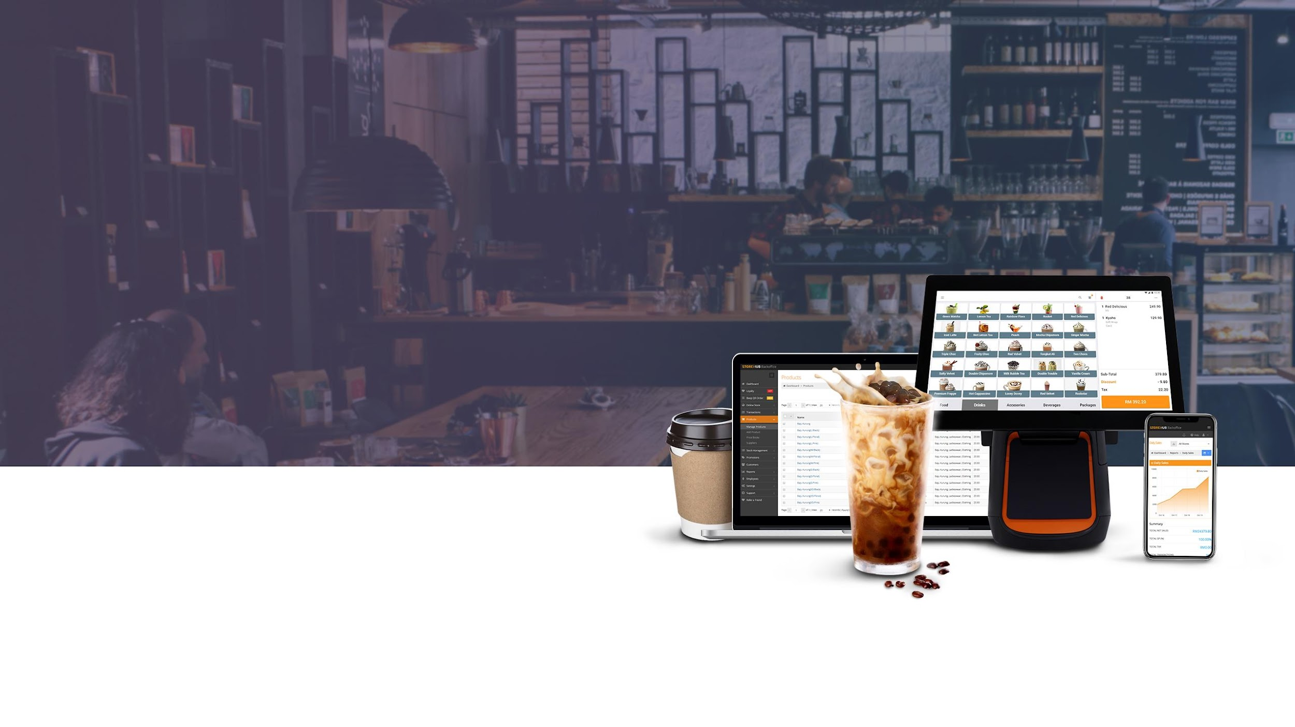
S.P.I.N Technique
(More applicable to Success Team)

Slide 41





Probing
S.P.I.N Technique
SPIN is a set of questions to be asked in a specific order.
What is Probing?
To ask on more details on a particular matter.
Probing questions are meant to clarify a point or help you understand the root of a problem, so you know how best to move forward.
1. S : Situation
2. P : Problem
3. I : Implications
TED = Tell, Explain, Describe

Slide 42
Probing
S.P.I
Situation
Problem
S
P
What is Situation Questions?
What is Problem Questions?
To gain a thorough understanding of the prospects' position/situation faced - from their processes, pain points, opportunities to their competitive plans and results
To identify areas of potential growth/problem needs to solve and provide the optimal solution
Example of Questions:
Example of Questions:
How do you track your sales now?
Who’s responsible for inventory management?
When did it start? (Eg. Printer issue)
How long does it take to calculate your sales?
How much do you need to pay?
What is the printer model?

Slide 43
Probing
S.P.I
Implication
I
What is Implication Questions?
Example of Questions:
I understand how frustrating it is on your end to [pain point/s]. If there was a way to have an all-in-one platform for real-time sales and inventory tracking, as well as your own & exclusive ordering site, would you consider it beneficial for your business?
Discuss the problem's consequences and amplify its gravity to increase the merchant's motivation to change
TED = Tell, Explain, Describe

Slide 44
Probing
Other Probing Techniques
1. Open Ended Questions
2. TED Questions
3. Leading Questions
An open question is a question that starts with 4W1H and cannot be answered with “Yes or No”
You will likely use open questions when:
You want to better understand the customer
You want to show interest in what the customer has to say
Allow customer to express frustration
Tell, Explain, Describe.
These probing TED questions help to pinpoint the relevant insight from a customer’s open response.
It helps to prompt the customer into giving the advisor all the relevant information in regard to their query.
Leading questions can be used well to influence a response.
Leading questions are designed to make the customer say yes, which can be a powerful tool in the art of persuasion.
4W1H = What, Why, When, Where, How
Notes:
Open Ended QUestions must allow merchants to express as much as possible.

Slide 45
Probing
Other Probing Techniques
1. Open Ended Questions
2. TED Questions
3. Leading Questions
Examples:
What are the main reasons you are dissatisfied?
When will you see your business utilising this feature the most?
How do you think our Engage feature will help you after understanding the benefits?
Examples:
How will this affect your business?
Do you mind explaining how did this situation begin?
What impact has this had on your business?
Examples:
Option A comes with free delivery, over time you will save money. Would that add value for you?
Most customers with the same needs as you opt for Option C. Would you like me to explain why?

Slide 46

Pop Quiz
Quiz Time!
Which of the following agent should NOT do for Empathy?
A. Listen before you speak
B. Respect everyone cultural differences
C. Control your cadence, pace & tone
D. Assume customer issues

Slide 47
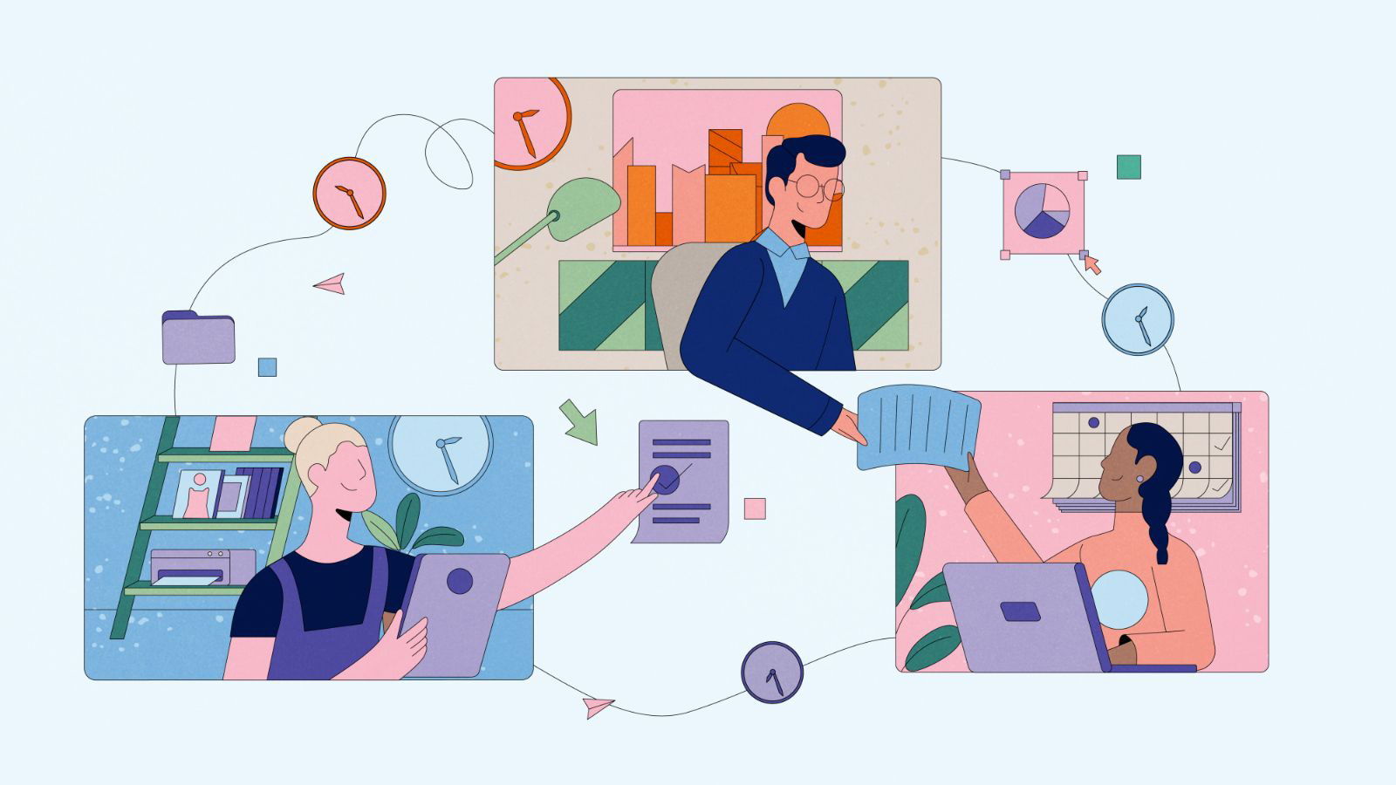
Solutions

Slide 48







Solutions
Nature of Inquiries
Hardware Related
Damage Item
Software Related
Cancelled Order
Servicing Related
Missing Item
Late Delivery

Slide 49


Solutions
Positive vs. Negative Words
Positive
Words
Giving good impression and showing certainty
Giving an impression of rejection or disagreement
Negative
Words

Slide 50


Solutions
Positive vs. Negative Words
Positive
Words
Negative
Words
Tells what can be done
Suggests alternatives and choices available
Being helpful and encouraging
Emphasis on positive actions and positive consequences
Defensive on the situation
Blames on Customer
Full of sarcasm and not helpful
Emphasis on consequences in a negative manner
Sample of positive words
Sample of negative words
I will
Surely
Concern
Let me explain/clarify
Let me get the person in charge to contact you
I recommend
I’m positive/certain
No
Maybe
If Not
Wrong
Actually
Cannot
Listen to me

Slide 51

Solution
Positive vs. Negative Words
POS = Point of Sales

Slide 52





Solutions
Ownership
Accountable
Hands-on
Resourceful
Dos
Don’ts
Take initiative to solve difficult cases
Convert customers problems into queries
Capable to guide customer on the process and procedures
Avoid cases that require escalation
Turn down customer despite of alternatives that can be provided
Neglecting customer and advising them to solve it on their own

Slide 53

Solution
Ownership
POS = Point of Sales

Slide 54
Solutions
Steps to Take Ownership
1
Acknowledge the Problem
Recognize customers' emotions as well, so they understand you're there to assist them
1
2
2
Focus on a Solution
Steer the conversation toward resolving the issue
3
3
Follow Up
Ascertain that issues has been resolved with the individual that he / she assigned it

Slide 55
Value Selling & Negotiation
(More applicable to Success Team)

Slide 56

Solution
Proposal - Value Selling
Negotiation
To recommend any available feature/ provide workaround after identifying pain points /opportunities.
A negotiation between a buyer and a seller to close a deal/ to retain the merchant
Main features for adoption:
StoreHub Engage
Beep QR
Beep CashBack
BO (Login frequency, Reports, Promotion)
Create the urgency and get the merchant to close on the spot (COTS)/ accept the suggestion/proposal
Notes:
Negotiation is about convincing merchants that they need SH in the face of churning

Slide 57
Solution
Proposal - Value Selling
1. Software
2. Hardware
3. Offer Alternatives/Workarounds
Suggest suitable plan/features for Merchant’s needs
Justify choices with use case scenarios
Explain differences in different plans
Suggest suitable hardware for Merchant’s needs
Non-StoreHub hardware may not work well with our POS app
May cause issue that Care Team cannot help with
Our software optimised for StoreHub hardware only
After understanding Merchant needs
Offer a workaround to achieve similar results
Or offer alternative setup or usage methods to get what Merchant wants
POS = Point of Sale
Notes:
Negotiation is about convincing merchants that they need SH in the face of churning

Slide 58
Solution
Proposal - Value Selling (Cont.)
1. Software
2. Hardware
3. Offer Alternatives/Workarounds
Examples:
We think the Pro plan suits your business better thanks to the lower trx fees since you use Beep very often.
If you drop down to Starter, you won’t be able to utilise the Promotions feature anymore, which is something you mentioned your business requires.
Examples
We understand that the T2 may be pricier, but it’s the best device available to handle your high trx volumes.
Our software and peripherals are optimised to work with our lineup of hardware; using third-party devices may cause many issues that we cannot help solve.
Examples
You can use our Order Ready Notification on top of Beep QR for your drive through idea.
You can use a personal tablet to showcase your promotions using Customer Facing Display.
POS = Point of Sale | trx = Transaction
Notes:
Negotiation is about convincing merchants that they need SH in the face of churning

Slide 59
Solution
Negotiation
1. Competitive Advantages
2. Identify Valuable Merchants
3. Avoid Downgrades/Churn
Always create a win-win situation for Merchants and SH
What sets StoreHub apart? Highlight key products in relation to Merchant’s needs
Help Merchants visualise profits gained if they renew
Create urgency
High Potential with MRR of above 700
Merchant has few competitors
Merchant products are unique
Merchant has a more than 1 branch with StoreHub
Help Merchants understand what their current plans offer
Compare benefits of each plan
Justify current/higher to Merchant’s business needs
MRR = Monthly Recurring Revenue | SH = StoreHub
Notes:
Negotiation is about convincing merchants that they need SH in the face of churning
It is also about creating win-win situations
What can customers gain from this negotiation
Example: If they want discount, we ask them to sign up for QR first.

Slide 60
Solution
Negotiation (Cont.)
1. Competitive Advantages
2. Identify Valuable Merchants
3. Avoid Downgrades/Churn
Examples:
We can do our best to get you a discount if you sign up for Beep QR; that way, you also cut costs on staff to handle orders.
You can easily entice your customers to return to your store with Engage, a feature that not all POS providers have.
Examples:
We value this partnership and are willing to provide an extension on your repayment
We understand that your multiple outlets are running on our systems and we want to serve each of them the best we can.
Examples:
Your plan actually allows you to utilise lower trx fees, so you should use Beep Delivery to expand your reach.
By downgrading, your E-commerce trx fees increase and you can upload fewer products; we recommend staying on Advanced and we’ll work on providing a discount for you.
MRR = Monthly Recurring Revenue | SH = StoreHub | trx = Transaction
Notes:
Negotiation is about convincing merchants that they need SH in the face of churning
It is also about creating win-win situations
What can customers gain from this negotiation
Example: If they want discount, we ask them to sign up for QR first.

Slide 61

Handle Objection

Slide 62

Handle Objection
Importance of Objection Handling
Why is Objection Handling is important?
An objection presents you with an opportunity to learn more about Customer
It enables to ascertain their ACTUAL needs, desires, and concerns (NWC)
It demonstrates credibility:
Product knowledge
Fostering trust
Unless you overcome the objection, they will never feel secure enough to proceed

Slide 63

Solution
Handle Objections
POS = Point of Sales

Slide 64






Handle Objection
Tips on Handling Angry Customer
Listen Carefully
Take Mental Notes
Use Same Terminology
Show Empathy
Provide Outcome

Slide 65

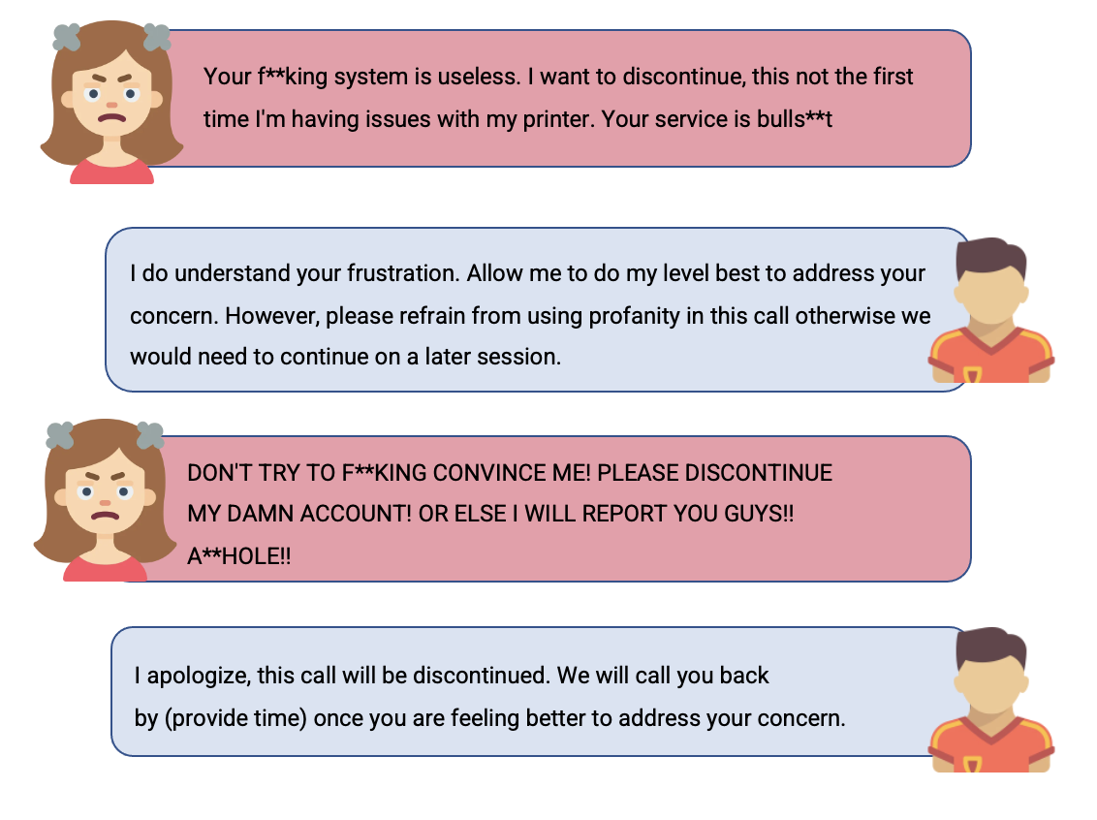
Handle Objection
Tips on Handling Unreasonable Merchants
When do you know steps should be taken before the player ends the conversation:
Example of conversation:

Slide 66
Handle Objection
Tips on Handling Unreasonable Merchants
Warnings:
1st Warning
“I do understand your frustration. Allow me to do my level best to address your concern. However, please refrain from using profanity in this call otherwise we would need to continue on a later session”
2nd Warning
“I apologize, this call will be discontinued. We will call you back by (provide time) once you are feeling better to address your concern.”

Slide 67





Handle Objection
Critical Thinking
Gather details from Customer, Knowledge Base & Modules
What are the possible solutions / conclusions?
Gather
Information
Consider
Implications
Apply
information
gathered
Explore
other points
of view
Ask Questions
Explore other points of view
Use appropriate process for each situation
(Alternative)
Other resolution could be better

Slide 68
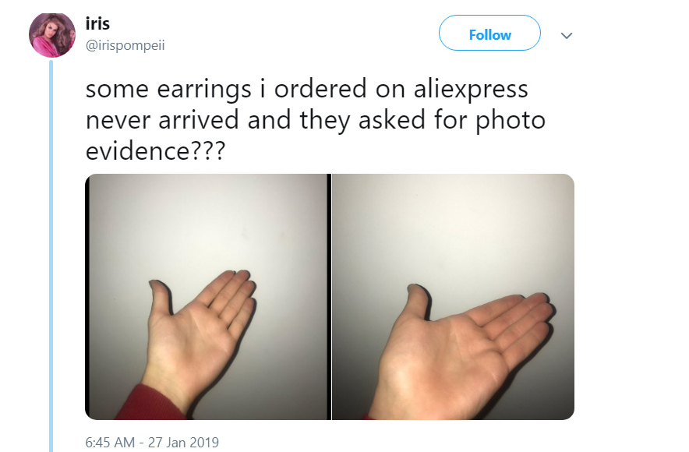

Handle Objection
Critical Thinking - Example
Asking correct questions
Gather information
Follow procedures

Slide 69

Closing

Slide 70



Closing
Tips on Closing
Recap
Recommend
Rate
Resolve issues that customers face
Inquire customer that the issue has been resolved
Remind customers that if they require assistance, they can always access our online database (which is available 24 hours daily)
Remind customers to rate us, as this will help us continue to improve

Slide 71
Closing
Tips on Closing
“Thank you for getting in touch with us today, we appreciate your support in choosing StoreHub to make your business awesome.”
“We hope you will find our recommendations useful in regards to your enquiry.”
“Do feel free to reach out to us with any questions.”
Recap
Recommend
Rate
"Always refer to our online guide at https://support.storehub.com/, which is available 24 hours daily."
“Is there anything else I can help you with today?”
“You may receive a survey of our service today and we would love to hear from you.”

Slide 72
Pop Quiz
Quiz Time!
Which of the following is FALSE about critical thinking?
A. Player should ask correct questions.
B. Player should use appropriate process for each situation.
C. Player should explore other alternatives (if any).
D. Player should only gather information from Knowledge Base.

Slide 73

Brand Servicing
Summary
Customer Experience
Level Up
What is Brand Servicing?
To make sure our merchant / customer will have awesome experience while communication with SH.
What is Customer Experience?
Impact that players did for our merchant / customer while communication with SH.
Greeting
Probing
Solution
Objection
Closing
Pillars
Role Play
Easy
Assemble a conversation that feels easy and natural for our Customers.
Recognize
Acknowledge and recognize the difficulties they face.
Solve
Whatever issues they have, we will take responsibility for resolving them.
To ensure that players are capable of utilising Brand Servicing when communicating with Merchants / Customers.
SH = StoreHub

Slide 74
Appendix
Terminology , Process & Scenarios

Slide 75

Appendix
Terminology
Churn
Renew
Refund
Downgrade
Merchant doesn’t want to continue subscription
Merchant wants to continue with subscription
Merchant asking for refund halfway of their subscription cancelation
Merchant wants to downgrade plan due to not using the feature (Beep/ Inventory) or limitations
Retain Credits
Credit Transfer
Merchant churn halfway of subscription, Chargebee generates extra credits
Stored credits of the merchant’s account
Service Recovery
Escalation
Reactivate
To retain customer, player would need to do service recovery
Player to handle case by case basis and ensuring of passing the case to T1/T2/ BE
Merchant wants to reactivate the old account subscription

Slide 76
Appendix
Terminology
Discount
Refuse to Upgrade
Situation
Action Plan
Merchant ask for discount for certain issues they are facing
Merchant wants certain features but does not want to upgrade
Merchant is explaining on the situation they are facing
Player to decide on the next action plan after merchant explains on the situation
Extensions
When merchant is asking to extend the subscription plan to another few months due to business closed down temporarily
Adoption
When merchant has adopted and comprehends the system
Refund
Special Case
When merchant wants refund due to server down issue
When there is a complicated case due to issue on SH’s end

Slide 77
Process & Scenarios
Recurring Issues (More Applicable for Success Team)

Slide 78

Recurring Issue
Scenario 1 (Controllable)
Merchant churn due to delayed payment from StoreHub / Beep Delivery Rider Issues
Probe Situation
Understand which date the payment did not come in
Close
Provide Assurance
Escalation & Follow Up
Service Recovery
(Compensation)
Speak to merchant with empathy
Constant follow up with Care /Beep Team & update merchant
Check with Coach on reasonable amount
Investigate Cause
of Issue
- Check if there is any payment issues
- Check with other departments (e.g. Finance)

Slide 79
Recurring Issue
Scenario 2 (Controllable)
Merchant found a basic and cheaper solutions
Follow Up
Hand over to AM (BE) to process renewal
Agree
If merchants needs time
Probe Situation
Negotiate / Value Selling
Based on the reason
- Find out which platform?
- Any particular feature? - Explain if SH has the feature - Find out if merchant has the info
- Highlight what they will lose if they churn
- Highlight the features that that SH has & the competitor does not
Churn
Close
Does Not Agree
Handover to AM (BE) to process account cancellation
SH = StoreHub | BE = Billing Executive

Slide 80
Recurring Issue
Scenario 3 (Controllable)
Merchant wants to churn due to Software & Hardware Issues
Probe Situation
Service Recovery
(Compensation)
Hand over to AM (BE)
Can be fixed
- Understand what issue is the merchant facing? (e.g. Report missing / Slow printer)
- When did this happened?
- How frequent?
- What is the App / iOS version
- Printer Model
Suggest Workarounds/Guide with troubleshooting
Troubleshooting Checklist
Check with Coach on reasonable amount
If merchant agrees to continue subscription
Based on the reason
Close
Can’t be fixed
Yes
Escalate to Care Team
Merchant Satisfied
- Check with T1 / T2 based on the severity of the case - Submit Feature Request JotForm
No
Request will be raised to Product Team, but do NOT overpromise Merchants
Churn
Important Notes:
JotForm requests are subject to review – feature not guaranteed to be in pipeline.
Handover to AM team (BE) to process account cancellation
BE = Billing Executive

Slide 81
Process & Scenarios
Feature Request
(More Applicable for Success Team)

Slide 82
Feature Requests
Scenario 1
Churn because features are not available
Probe Situation
Provide Guidance
Hand over to AM (BE) to process renewal
Yes
Yes
Investigate Cause of Issue
Feature available?
Show how to utilise features
Service Recovery
(Compensation)
Merchant satisfied?
No
Close
Suggest Workarounds
No
OR
Request will be raised to Product Team, but do NOT overpromise Merchants
If No Workaround, Submit Feature Request JotForm
Churn
Hand over to AM (BE) for account cancellation
Important Notes:
JotForm requests are subject to review – feature not guaranteed to be in pipeline.
AM = Account Manager | BE = Billing Executive
Notes:
Brand Servicing Deck - https://docs.google.com/presentation/d/1KWKCTYmkPnd-Ex9Y7iF0wUW3Np7SlkAMJlyl-7Y-LOc/edit#slide=id.gc6b3e73bde_0_312
Example scripts– Workaround
“Unfortunately, currently this feature that you mentioned about it is not available right now. However, fret not as I am able to guide you an alternative way to get what you want [insert alternative steps]… Does this work for you?”
Example script – No workaround
“Unfortunately, we do not have the specific feature you are looking for right now, however I am more than happy to assist to channel your request to the Product Team. Could you please tell me more about it? …… (after merchant finishes).
Awesome, I have taken down your request and will do the due diligence to channel it to my colleagues. Since we have a number of exciting requests coming in from other merchants as well, our colleagues will try their best to prioritize all requests accordingly.
If your excellent suggestion has been selected, we will definitely get back to you about it.”

Slide 83
Feature Requests
Scenario 2
Features not user friendly – Merchants request for simpler features
Probe Situation
Provide Guidance
Hand over to AM (BE) to process renewal
Yes
Yes
Investigate Cause of Issue
Feature available?
Show how to utilise features
Service Recovery
(Compensation)
Merchant satisfied?
No
Close
Lack of education or does not fit business?
Suggest Workarounds
No
OR
If No Workaround, Submit Feature Request JotForm
Churn
Request will be raised to Product Team, but do NOT overpromise Merchants
Hand over to AM (BE) for account cancellation
Important Notes:
JotForm requests are subject to review – feature not guaranteed to be in pipeline.
Sell the value of existing features - explain using use cases.
AM = Account Manager | BE = Billing Executive
Notes:
Merchants might find certain features user friendly due to lack of education previously
Simpler

Slide 84
Feature Requests
Scenario 3
Merchants prefer older versions of a feature that is no longer available
Probe Situation
Investigate Cause of Issue
Hand over to AM (BE) to process renewal
Yes
Provide Guidance
Merchant satisfied?
Value selling of existing features
No
Yes
Service Recovery
(Compensation)
Close
Suggest Workarounds
Merchant satisfied?
No
OR
If No Workaround, Submit Feature Request JotForm
Churn
Hand over to AM (BE) for account cancellation
AM = Account Manager | BE = Billing Executive
Notes:
Provide Guidance
Sell value of existing features and encourage merchants to adopt.

Slide 85
Feature Requests
Scenario 4
Feature not within StoreHub’s pipeline/direction
Probe Situation
Investigate Cause of Issue
Understand how the feature would impact their business
Yes
Hand over to AM (BE) to process renewal
Negotiate / Value Selling
Merchant satisfied?
Service Recovery
(Compensation)
Close
Show how Merchants can utilise existing features to help business
Suggest Workarounds
Merchant satisfied?
No
OR
If No Workaround, Submit Feature Request JotForm
Churn
Hand over to AM (BE) for account cancellation
AM = Account Manager | BE = Billing Executive
Notes:
Provide Guidance
Sell value of existing features and encourage merchants to adopt.

Slide 86
Process & Scenarios
Service Related
(More Applicable for Success Team)

Slide 87
Service
Scenario 1
Wrong expectations set from start of customer journey / false promises
Probe Situation
Investigate Cause
of Issue
Confirm issues
Hand over to AM (BE) to process renewal
Yes
Find out player’s name & what happened
Locate source of breakdown
Escalate to Coach
Service Recovery
(Compensation)
Follow up
Merchant Satisfied?
Close
OR
Follow up with Sales Player on correct expectations
No
Churn
Hand over to AM (BE) for account cancellation
AM = Account Manager | BE = Billing Executive
Notes:
Service recovery is not a must if merchant willing to stay on without compensation

Slide 88
Service
Scenario 2
Upset because no follow up on promised callbacks/problems taking too long to be solved
Escalate to Coach
To seek optimal solution/workaround
Probe Situation
Yes
Hand over to AM (BE) to process renewal
Investigate Cause of Issue
Confirm issues
Coach
Needed?
Yes
Look for relevant Intercom tickets, or past complaints
No
Provide Solution/Workaround
Merchant satisfied?
Service Recovery
(Compensation)
Close
OR
No
Churn
Hand over to AM (BE) for account cancellation
AM = Account Manager | BE = Billing Executive

Slide 89
Service
Scenario 3
Churn due to logistics related problem
Probe Situation
Confirm issues
Hand over to AM to process renewal
Late arrival / damaged goods / wrong address
Provide Assurance
Yes
Escalate to Care Team
Follow up
Merchant satisfied?
Care Team will follow this process here
Care Team will follow this process here
Service Recovery
(Compensation)
Close
No
OR
Churn
Hand over to AM (BE) for account cancellation
AM = Account Manager

Slide 90


The Platform for Awesome Businesses
The End
THIS DOCUMENT IS STRICTLY PRIVATE AND CONFIDENTIAL. THIS IS INTENDED FOR INTERNAL USE ONLY; DO NOT CIRCULATE
Copyright © 2023 StoreHub. All rights reserved. No parts of this document can be reproduced, distributed, transmitted or stored electronically without StoreHub’s prior written permission.
21

